Slide 2
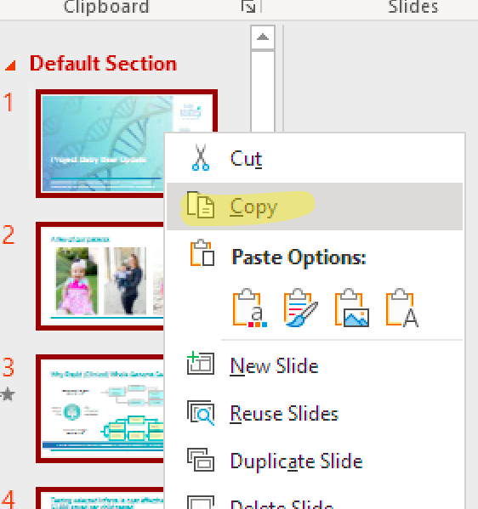
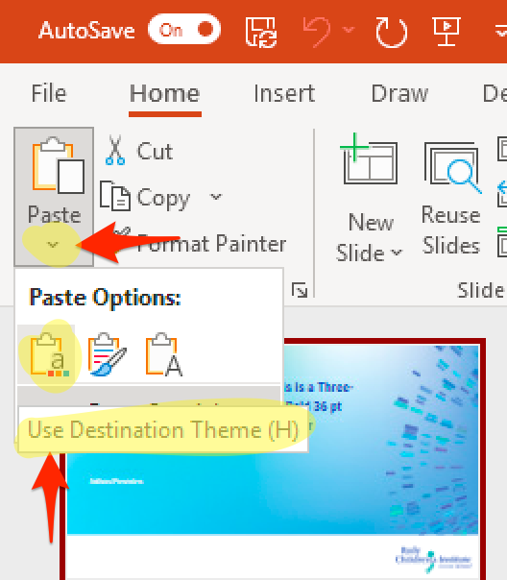
Copying Your Slides into the Frontiers Template
Open your existing slide deck. Select the thumbnail of all the slides from the old file, and hit Copy.
In the new file, click the dropdown triangle on the Paste icon in the Home toolbar/ribbon, and select “Use Destination Theme.”

Slide 3
Disclosures

Slide 4
Learning Objectives

